Slide 1
Paramedic Chiefs of Canada Strategic Plan Update

Slide 2
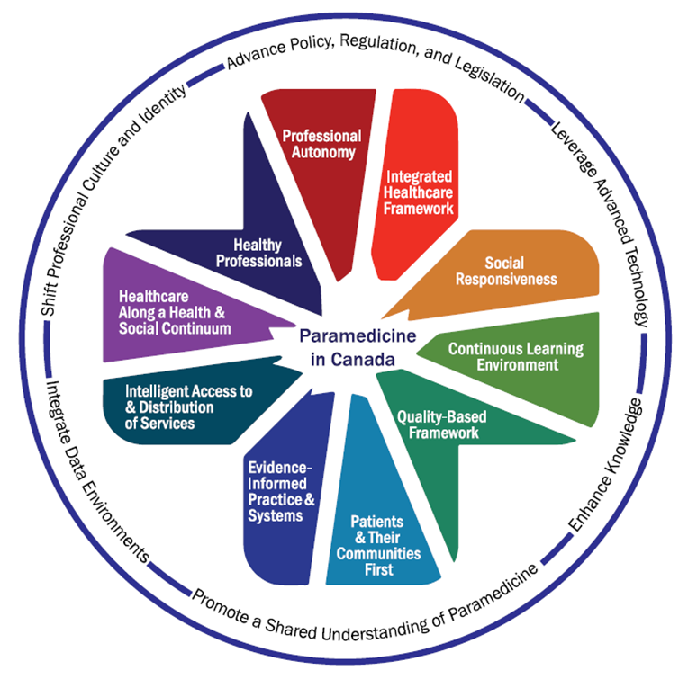
Aligning Vision with Strategy

Slide 3
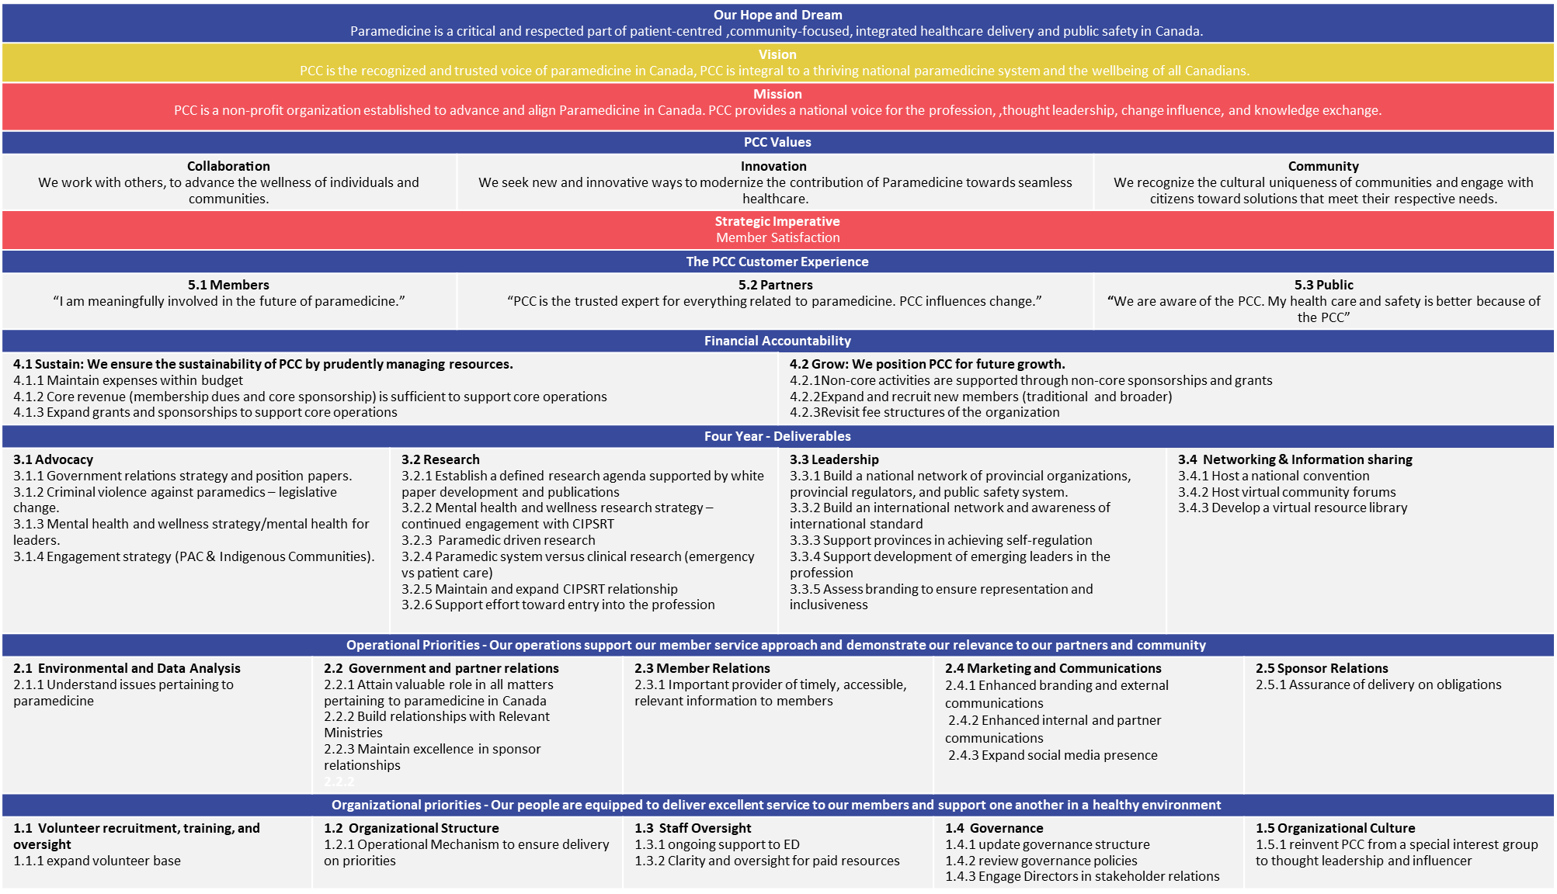

Slide 4
Our Aspiration

Slide 5
Four Key Objectives
Advocacy – Randy Mellow, Lead
Research – Jan Jensen, Lead
Leadership – Mike Adair, Lead
Networking and Information Sharing – Gerry Schriemer, Lead

Slide 6
Advocacy
Government relations strategy and position papers
Violence in paramedicine
Mental health and wellness strategy
Strategic Engagement

Slide 7
Advocacy - Deliverables
Develop strategy for the creation of Federal Secretariat of Paramedicine
Complete an environmental scan to inform engagement with government tiers
Develop strategy to engage government in a response to HESA-129 (Violence to Paramedics)
Advocate for a national research project focused on leadership mental health. Quantify mental health injuries in leadership.

Slide 8
Research
Through the actions of a PCC research committee, the PCC aims to:
Foster an environment to advance paramedic driven research​
Support the establishment of an updated defined research agenda
Drive and support the completion of targeted research projects linked to aspects of PCC Visioning document, the updated Research Agenda and priority topic areas for PCC and its membership
Develop and support paramedic and paramedic leadership mental health and wellness research
Advance the establishment of standardized outcome measures for paramedicine in Canada

Slide 9
Research - Deliverables
Actions:
Recruit paramedic researchers to be part of the PCC through the re-establishment of the PCC Research Committee.
Through survey of PCC membership, foster the completion of research and evidence reviews through various activities including but not limited to:
Funding or supporting studies and evidence reviews in line with the Guiding Principles document and the updated Research Agenda
Providing letters of support for grants
Creating knowledge translation opportunities.
Maintain, develop relationship with partner research agencies including but not limited to DRDC, CIPSRT, CSA and other groups working to advance Canadian paramedic research and the use of research to drive standards
Scope out work to standardize key measures

Slide 10
Leadership
Build a national network of health care provincial organizations, provincial regulators, and public safety systems.
Build and international network and awareness of international standards
Support provinces in achieving self-regulation
Support development of emerging leaders in the profession

Slide 11
Leadership - Deliverables
Actions:
Identify target audience and stakeholders by Province and Territories. Connect with them and ascertain interest in being part of a national network
Re-establish connection with Global Paramedic Leadership Alliance (UK,AUS,USA,CDN) / Foster existing partnership
Make all Provincial and Territorial Paramedic Acts/Legislation/Regulation available on the PCC website (virtual library)
Re-establish leadership development committee and Mentorship program

Slide 12
Networking and Information Sharing
Host an annual Summit
Host virtual community forums
Develop a virtual resource library

Slide 13
Networking and Information Sharing
Actions:
Re-strategize - coordinate with potential partners to review the Annual Leadership Summit
Develop a community forum on current and on-going topics and create an information sharing platform
Virtual library - categories relevant to the resource library

Slide 14
Call to Action
We now need the help of PCC members and partners like you to participate and lend your expertise by participating in committees and working groups to be successful.

Slide 15
Standing Committees Required
Finance
Governance
Advocacy
Research
Leadership
Networking and Information Sharing

Slide 16
Thank you
Please send indicated your area of interest and send to PCCstratplan2023@paramedicchiefs.ca

Slide 17
Thank you for your support!
What do you want or need from PCC to be an active partner in advancing paramedicine in Canada?

