Slide 1

Paramedic Services Week
Our Family Caring for Yours!
May 25 to May 31, 2014

Slide 2


Committee
Lyle Karasiuk, Parkland Ambulance Care, Saskatchewan (Chair)
Andre Berard and Tristin Klassen, Winnipeg Fire and Paramedic Service
Stuart Brideaux and Adam Loria, Alberta Health Services
Gale Chevalier Frontenac Paramedic Services, Ontario
Michael Janczyszyn and Brianna Colford, Emergency Medical Care, Nova Scotia
Sophie Cormier-Lalonde and Tracey Bell, New Brunswick EMS
Kelsie Carwithen, BC Ambulance
Charlene Vacon, Urgences-Sante, QC
Stuart McKinnon, Ontario
We are a working group of the Membership Services Committee
Paramedic Chiefs of Canada
THANK YOU!

Slide 3
Why the week is
May 25-May 31
Paramedic Chiefs of Canada have proclaimed the week to align the week for Canadians. 2nd Year we’ve been the week after the USA week.
Previous years have started on the May long weekend meaning that events typically wouldn’t start till Tuesday leaving a shortened Canadian week.
Create a unique Canadian EMS/Paramedic week
May 25 to May 31, 2014

Slide 4
What will be happening
National Media Release
National Proclamation
National Media Launch through PCC Board
Social Media campaign
EMS Week package
  Designed around giving you ideas and suggestions.
Please share your ideas, plans, and most of all show us through video, pictures or posters what you are doing for the week.

Slide 5
Our Logo
Careful play on the PCC logo
  Indicates the brand
Central part of the logo will remain constant year after year
Three “dancing” figures represent the theme Our Family Caring for Yours! This would change in subsequent years.
Logo will be available on the PCC web site to download. Below the wing on right will be the theme, title and date.

Slide 6

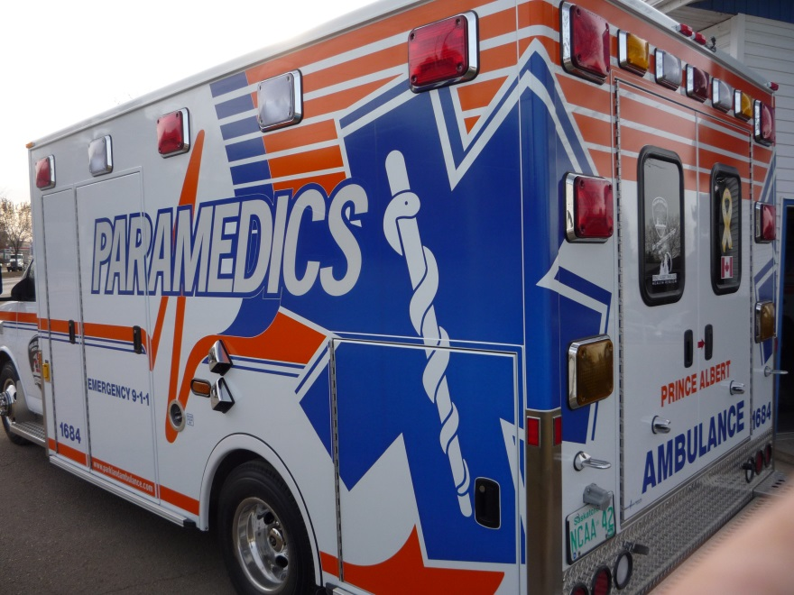
Why Paramedic Services Week vs Emergency Medical Services Week?
The adoption of national occupational competency profiles and provincial legislation, in several jurisdictions, has identified the term “paramedic” to be the generic term for all out of hospital care providers. No matter where they work, who they serve or roles they provide the term “paramedic” recognizes the professionals who in many ways serve Canadians with exceptional out of hospital emergency or community care. The public, government and other allied health professions know, recognize and appreciate the professional under the banner of a paramedic.

Slide 7
How you can get involved?
Twitter #psweek2014
Email psweek@paramedicchiefs.ca
Send us pictures, video, newspaper clippings just about anything connected with your week and your activities.
This year PSweek goal is not about producing activities but about engaging people coast to coast to share and talk.
We want to know about your team, the faces, the activities, the sites and sounds of your communities. We want you to be a part of the week!

Slide 8
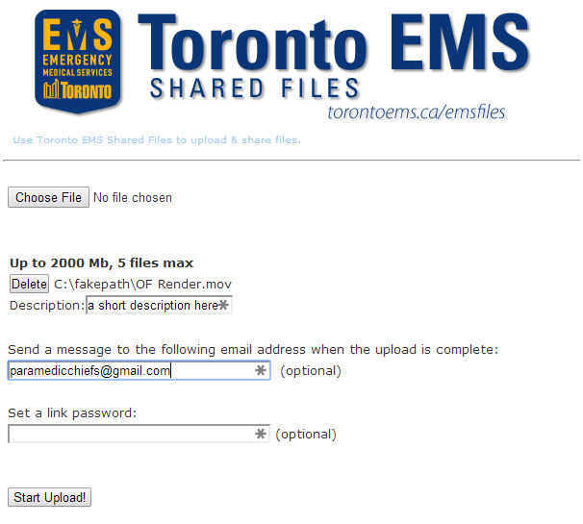
Video - Shoot it
Record video of your Paramedic Services Week events and activities. It doesn’t have to be perfect. Here are some specs and tips as a guide.
Framing your video: Clips from speeches, events, activities, your own reporting….we want it!
Recording: Set your device to the highest quality setting. 1080p video is preferred.
Shooting with a DSLR or pro camera? Most file types are ok.
Shooting with a smartphone? Look here, here, and here for some tips to get good results.
Send it
Send us your videos, please!
Browse to http://torontoems.ca/emsfiles/
Select the files to share “Choose File”. You can upload 2000MB at a time. Feel free to upload in multiple segments
Be sure to enter a short description of your video so we can caption it appropriately
Please use paramedicchiefs@gmail.com in the “Send a message too…” box so your submission goes to the right place.
We’ll download the submissions daily at 23:00 EDT

Slide 9
Share it
Every night after 23:00 EDT, we’ll download them and edit the best clips together into a short segment for posting to the Paramedic Chiefs of Canada YouTube channel. A summary edit of the clips will be posted the following day to YouTube, and shared via Twitter and Facebook. Look for the #PSweek2014 tag.
Help is spread the message by sharing the posts.
Photos - Shoot it
Give it your best shot. Look to Flickr for tips on formats.
Share it
Join our Flickr pool!
Upload your photos and post them to the group. Don’t forget to tag your posts with #PSweek2014.

Slide 10
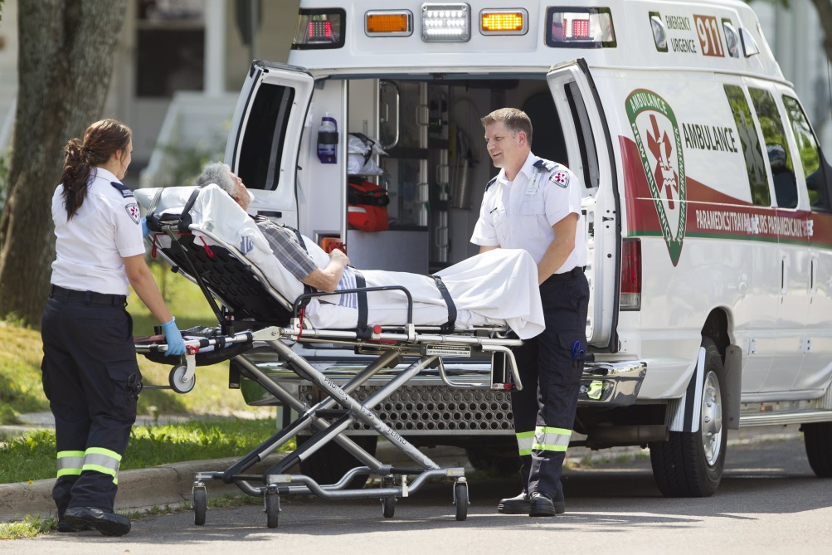
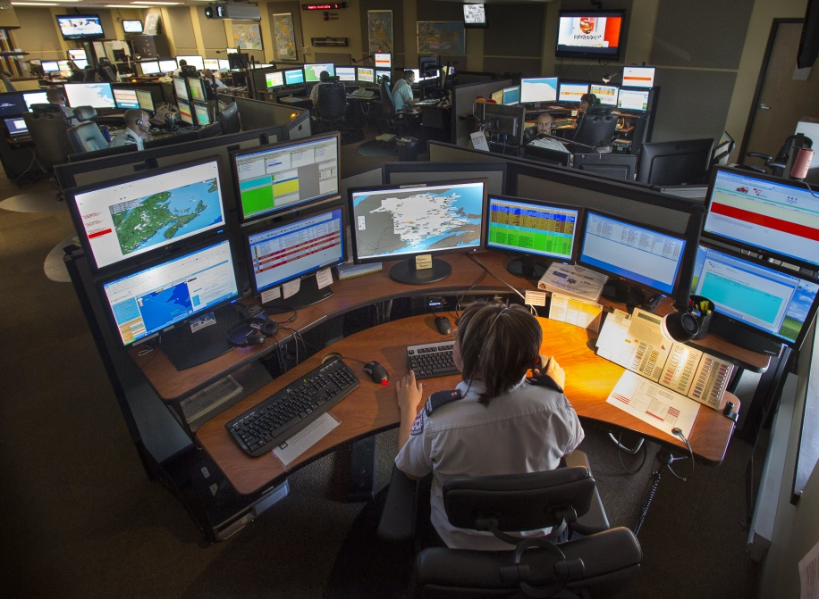
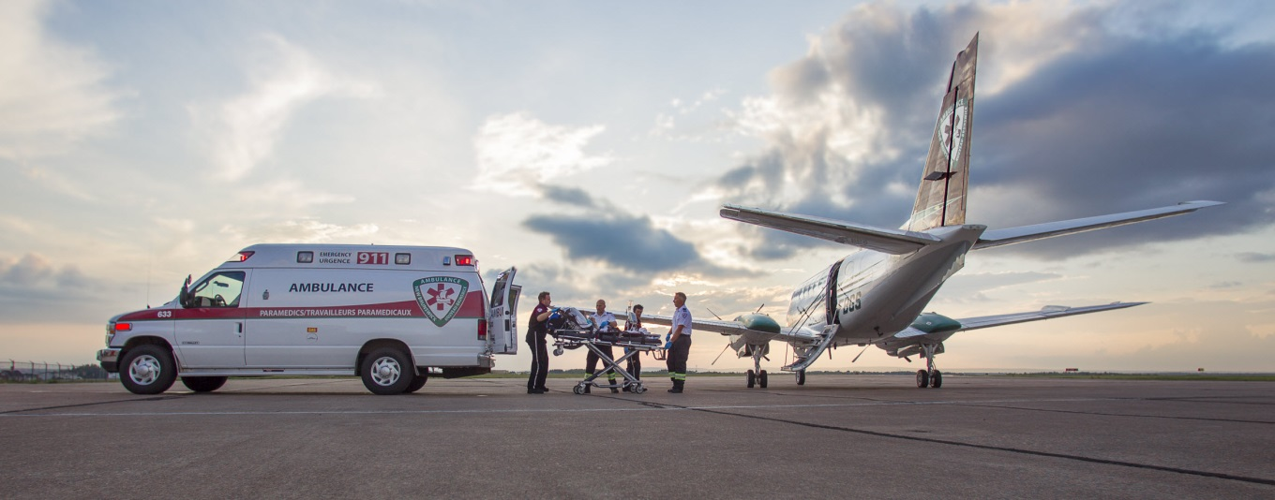

Slide 11
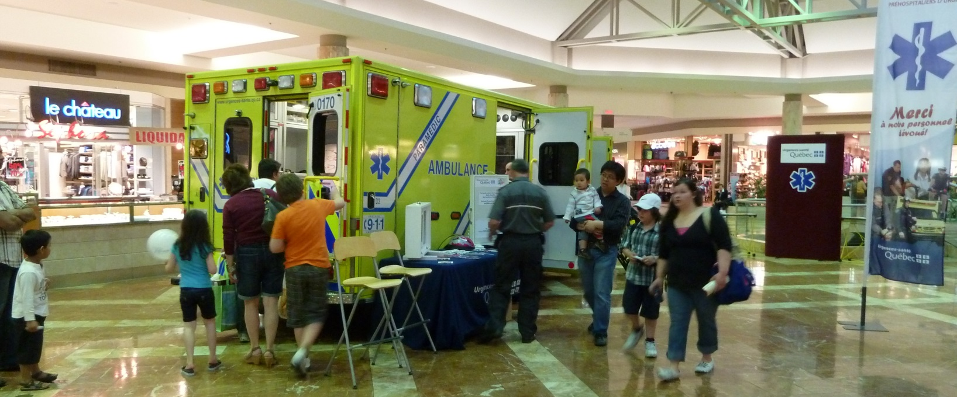
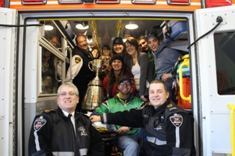
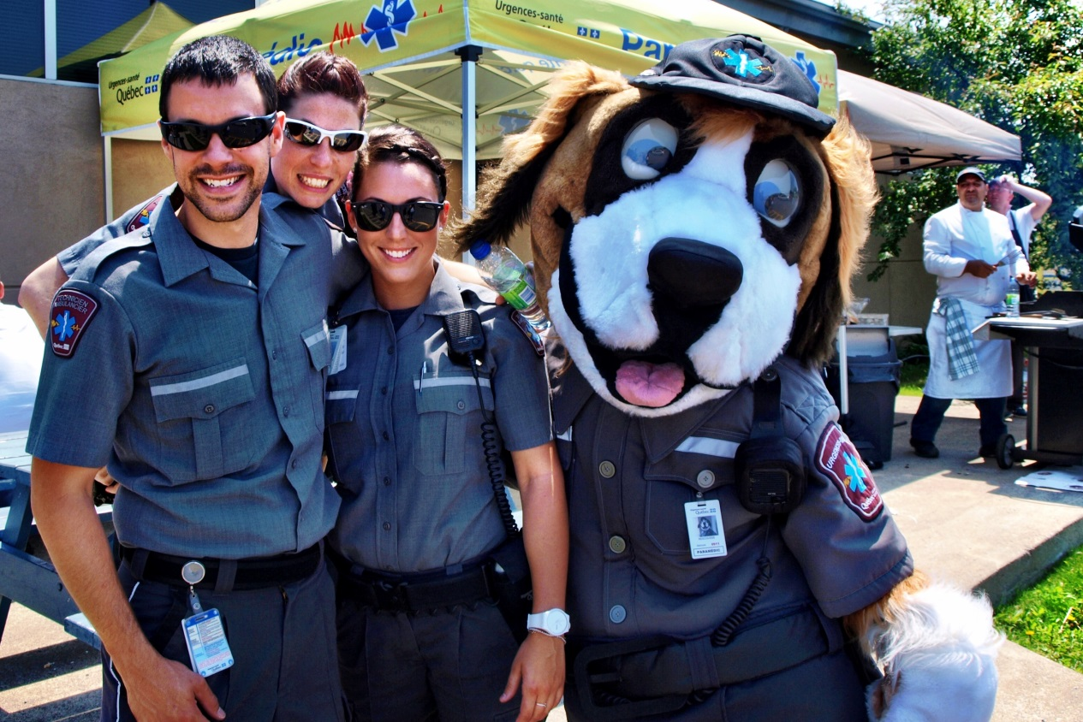

Slide 12

Paramedic Services Week
May 25-31, 2014
Our Family Caring for Yours!
Semaine des services paramédic
25 au 31 mai, 2014
Prendre soin de notre famille pour vous!
Twitter #psweek2014
Email: psweek@paramedicchiefs.ca
Or lyle@parklandambulance.com

